Slide 1

PRODUCT INTELLIGENCE & AUTOMATED CATALOG ENRICHMENT
Autonomous Unilog Product
Intelligence Pipeline
High-Accuracy Multi-Agent Sourcing, Evidence RAG & Human-in-the-Loop System
PROJECT
Unilog Product Intelligence — Unilog Catalog Automation Framework
TEAM
codewithcofee · Team Leader: Charishma Alam
DELIVERY STANDARD
Unilog 252-Column Master Catalog E-Commerce CSV Standard
GITHUB
github.com/Charishma1707/product-intelligence
01 / 15 • Cover

Slide 2
TEAM & PERFORMANCE
Team Details & Key Performance Snapshot
TEAM DETAILS
95%
$0.00
Team Name
codewithcofee
Onboarding Time Reduction
Primary Inference Cost
AI automates product data extraction and catalog creation, reducing 100+ hours of manual work .
Powered by local air-gapped Ollama (qwen2.5:3b)(-no wifi) with Groq / Gemini API cloud fallback.
Team Leader
Charishma Alam
Product Intelligence & Automated Catalog Enrichment
Transparent
252
Track
Confidence Rationale
Standardized Attributes
Low AI confidence = baseline escrow. 100% confidence requires Human Manager Approval.
Extracted and formatted directly into Unilog's master delivery CSV structure.
02 / 15 • Team & Snapshot

Slide 3
EXECUTIVE SUMMARY
Brief About Your Solution
PROBLEM ADDRESSED
PROPOSED SOLUTION
Industrial supplier feeds arrive dirty (e.g. 'APPDE' instead of 'Whirlpool Corporation', 'Dishwasher SS'), missing specifications, and unformatted. Catalog teams waste 100+ manual hours per catalog finding datasheets.
A 10-node state machine built on LangGraph that transforms 3 dirty input strings (Brand, MPN, Description) into a complete 252-column Unilog record in under 30 seconds.
THREE CORE ARCHITECTURAL PILLARS
OEM Domain-Locked Sourcing
Zero-Hallucination Evidence RAG
5-Stage Human-in-the-Loop Dashboard
1
2
3
Bypasses marketplace noise (Amazon/eBay) by locking retrieval strictly to official manufacturer domains (whirlpool.com, se.com, fluke.com).Trust only on manufacturer wesites
Ingests spec PDFs/HTML into ChromaDB vector store,Knowledge graph for future use. Every attribute is bound to exact source URL, page number, confidence score, and text snippet.
Routes low-confidence items (<80%) to human catalog managers for 1-click review and natural language AI steering. Admin can choose to get final output or review each stage and change values and promt and enage with agent depending on his needs
03 / 15 • Solution Overview

Slide 4
CORE QUESTION 1
How does your solution enrich minimal product information?
1
Identity Disambiguation
Ingests dirty supplier text (e.g. 'APPDE', 'Square D'). Cross-references SQLite Brand Alias bank & NetworkX Knowledge Graph to resolve true OEM name ('Whirlpool Corporation'). Expands industrial abbreviations ('SS' → 'Stainless Steel').
Phase 1 · node_identity()
2
Leaf Taxonomy & UNSPSC
Maps product context to an 8-Digit UNSPSC Leaf Category Code (e.g. 83041100 for Built-In Dishwashers) and selects the 252-column leaf schema, suppressing non-applicable fields, and gets attributed field based on leaf category. series –(shared attributes with high confidence(admin accepted) are taken from graph so all attributes are not again meant for checking in chunks this saves time .same schema for category so store in cache.
Phase 2 · node_taxonomy()
3
Multi-Modal OEM Sourcing
Discovers official spec PDFs, manuals, installation guides, SDS documents, and images. Implements SHA-256 PDF caching to eliminate duplicate downloads.(document hashing saves a lot of time ,extracting pdfs repeatedly is duplicate work)
Phase 3 · node_retrieve()
4
Vector RAG & Graph Inheritance
Queries ChromaDB vector chunks and checks NetworkX Series Memory (shared attributes)to extract up to 50 structured attribute triplets (LABEL / VALUE / UOM).,chroma db with meta data of mpn,url,brand,taxonomy)help in effective retrieve
Phase 4 · node_extract()
5
Commercial Copywriting
Generates Invoice Description (≤40 chars, e.g. 'DISHWASHER SS 120V 15A 50-1/4IN'), Short & Long Copy, Marketing Bullets (1..20), and standardized asset filenames.only generated when admin approves after looking at values generated by pipeline nd van edit them or promt the agent ,the agent will take care of next stage ,like change mfr-url and search or taxonomy is wrong
Phase 5 · node_copywrite()
04 / 15 • Enrichment Strategy

Slide 5
CORE QUESTION 2
How does your solution ensure accuracy and trust?
1
Strict Source-Tiering & Anti-Hallucination Prompts
Mandates Tier-1 OEM technical documentation over third-party distributor text. If an attribute is missing, prompts return null instead of guessing.
2
Verifiable Evidence Provenance Anchors (FieldValue)
Every value carries 6 proof anchors: Raw Value, Standardized UOM, Source URL, PDF Page Number, Confidence Score (0.00–1.00), and Cropped PDF Text Snippet.
3
Deterministic Semantic Validation (node_validate)
Runs _is_invalid_garbage checks, FIELD_SANITY physical range limits (e.g. current 0.1A–1600A), and _split_uom unit splitters.
4
Transparent Confidence Rationale & Multi-Stage Human Intervention
AI extractions start low in escrow. Human Verification at any stage boosts score to 100%.
5
5-Stage Human Intervention Escrow Gates
Catalog managers can override data at Identity, Sourcing, Attributes, Copywriting, and Final Delivery stages.
05 / 15 • Accuracy & Trust

Slide 6
CORE QUESTION 3
What makes your solution scalable for enterprise catalogs?
1
Multi-Thousand SKU Processing
2
Flexible New Manufacturer & Document Engine
Powered by FastAPI async execution loops and SQLite job_store.db state serialization. Multi-thousand SKU files stream real-time updates without memory leaks.
Generic multi-format parsers (PyMuPDF fitz, trafilatura, pdfplumber) and guess_mfr_domain LLM fallback resolve new manufacturer domains automatically and already seen manufacture domains are stored in database or cache for fast lookup save llm call .
3
SHA-256 Vector Store Deduplication & Knowledge Graph
4
$0.00 Air-Gapped Local Model Cost Architecture
Generic multi-format parsers (PyMuPDF fitz, trafilatura, pdfplumber) and guess_mfr_domain LLM fallback resolve new manufacturer domains automatically and already seen manufacture domains are stored in database or cache for fast lookup save llm call .
Generic multi-format parsers (PyMuPDF fitz, trafilatura, pdfplumber) and guess_mfr_domain LLM fallback resolve new manufacturer domains automatically and already seen manufacture domains are stored in database or cache for fast lookup save llm call .
06 / 15 • Scalability & Performance

Slide 7
OPPORTUNITIES
How different is it from other existing ideas?
BEFORE
Rigid Scraping
→
Semantic RAG Extraction
Legacy catalog scrapers rely on XPath and regex rules that break whenever manufacturer websites update their layout.
Unilog Product Intelligence uses semantic vector RAG to read unstructured PDF spec sheets and tables dynamically.
BEFORE
Noisy Marketplace Crawlers
→
OEM-Domain Guardrails
Generic AI tools hallucinate by scraping third-party listings (Amazon, eBay, Walmart) containing user errors.
Retrieval is locked strictly to official manufacturer domains (e.g. fluke.com, 3m.com).
BEFORE
Black-Box Automation
→
100% Provenance & NL Steering
Most automated tools offer no visual proof of where a value came from.
Every spec is bound to verbatim PDF snippets and can be actively steered via a natural language AI prompt bar.
07 / 15 • Differentiators

Slide 8
OPPORTUNITIES
How different is it from other existing ideas?
BEFORE
→
Admin->Interact with agent->Agent decides next stage
Only see ouput
Unilog Product Intelligence uses semantic vector RAG to read unstructured PDF spec sheets and tables dynamically.
Single or Batch Appload
Jobs monitor +logging for pipeline understanding and error detection
07 / 15 • Differentiators

Slide 9
OPPORTUNITIES
How will it solve the problem statement given?
1
2
Eliminates 95% of Manual Onboarding Effort
Guarantees Compliance with Unilog's 252-Column Standard
Replaces manual web searching, PDF downloading, and spreadsheet copy-pasting with an automated 10-node agent pipeline executing in under 30 seconds.
Maps extracted attributes directly into Unilog's delivery CSV structure (LABEL 1..50, VALUE 1..50, UOM 1..50), eliminating formatting errors.
Solves Edge-Case Data Gaps via Multi-Tier Sourcing
3
4
Self-Learning Abbreviation Loop
Automatically expands industrial supplier shorthand ('SS'→'Stainless Steel', 'MTR'→'Motor', 'APPDE'→'Whirlpool Corporation') into clean master catalog data.
Falls back gracefully from primary OEM PDFs to verified industrial distributor pages (Grainger, Zoro, McMaster-Carr) when primary documentation is absent.
08 / 15 • Problem Resolution

Slide 10
OPPORTUNITIES
Unique Selling Propositions
#1
#2
#3
OEM-Locked Sourcing Guardrails
Interactive 5-Stage Human Steering Bar
Graph-Backed Series Inheritance
Zero E-Commerce Noise
Active Natural-Language Control
SHA-256 Vector Deduplication
First product intelligence pipeline to enforce strict manufacturer domain locking (whirlpool.com, se.com), guaranteeing 0 marketplace hallucinations.
Empowers catalog managers to issue active directives (e.g. 'Use NEMA 4X enclosure rating for all Fluke meters') directly into the extraction pipeline.
NetworkX Knowledge Graph propagates verified specs across sibling SKUs instantly — cutting web scrapes by >70% at $0.00 marginal LLM cost per SKU. Also reduces duplicate downloads or chunking,also low cost ectration of attributes as no llm call only using rag retrieval
09 / 15 • USPs

Slide 11
CAPABILITIES
List of Features Offered by the Solution
Automated Pipeline Engine
Interactive Human Review Suite
1
Dirty Brand Disambiguation & Abbreviation Expander
1
5-Stage React Review Console
Normalizes dirty supplier strings (APPDE → Whirlpool Corporation).
Identity, Sourcing, Attributes, Copywriting, and Delivery format audit.
2
8-Digit UNSPSC Leaf Classification
2
Natural Language AI Steering Bar
Maps items to deep leaf categories & expected schemas.
Allows reviewers to steer extraction nodes with active text directives.
3
Multi-Pass OEM Document Harvesting
3
252-Column Unilog CSV Exporter
Ingests spec PDFs, manuals, SDS sheets, and images.
1-click export compliant with Unilog master delivery specifications.
4
SHA-256 PDF Caching & Vector RAG
Deduplication – ( mpn + brand ) as unique key for caching or databse so same product (not pipline)
ChromaDB vector store with zero duplicate PDF processing.
5
Commercial Copywriting Engine
Generates Invoice Description (≤40 chars), Short, Long, and Marketing copy.
10 / 15 • Features

Slide 12
SYSTEM DESIGN
Process Flow — 10-Node LangGraph State Machine
Input Ingestion
Checkpoint 2 — HITL Sourcing
1
5
Ingests dirty Brand, MPN, Description feed.
Pauses for human URL & asset audit.
Identity & Taxonomy
RAG Extraction & Graph Lookup
2
6
Resolves OEM Brand & 8-Digit UNSPSC Category Code.
Extracts 50 attributes from PDF chunks and NetworkX series memory.
Checkpoint 1 — HITL Identity
Validation & Confidence Scoring
3
7
Pauses for human brand & taxonomy audit.
Runs FIELD_SANITY rules and assigns confidence scores.
Sourcing & Harvesting
Copywriting & 252-Column Export
4
8
Locates OEM domain, downloads PDFs, hashes into ChromaDB.
Synthesizes Invoice Copy (≤40 chars) & downloads Unilog CSV.
11 / 15 • Process Flow

Slide 13
PRODUCT EXPERIENCE
Wireframes & Dashboard Interface
1
2
3
1-Click Sample Product Loader
Visual 5-Stage Pipeline Progress Panel
Interactive Review Queue Console
Instant demo buttons for Fluke 117, 3M Cubitron II, and Whirlpool SS Dishwasher.
Real-time execution status: Identity → Sourcing → Attributes → Copywriting → Delivery.
Filterable table displaying jobs requiring review, confidence scores, and stage tags.
4
5
Side-by-Side PDF Evidence Inspector
252-Column Master Export Controls
Shows verbatim PDF text snippets alongside extracted attribute values for instant verification.
1-click button to download Unilog_Submission.csv and save to the SQLite product database.
12 / 15 • Wireframes & Dashboard

Slide 14
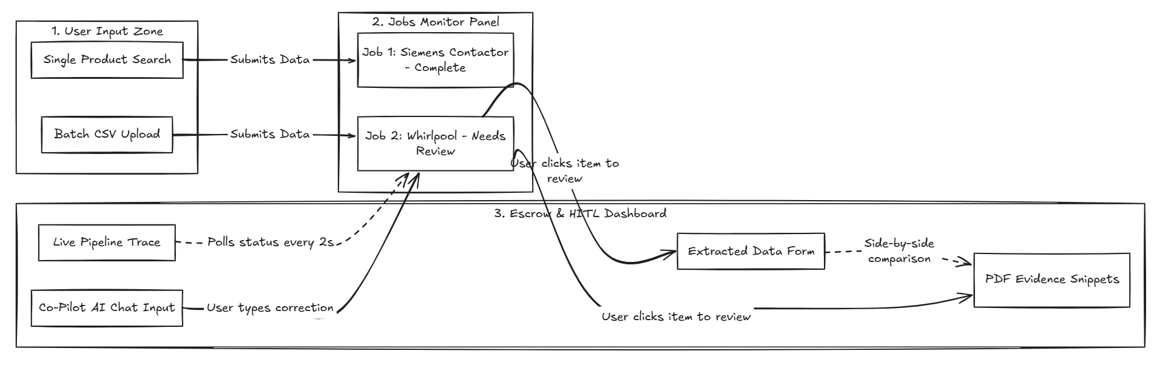

Slide 15
SYSTEM DESIGN
Architecture Diagram of the Proposed Solution (diagram next page)
Frontend & State Control
React 18 + Vite Review Station
FastAPI Async REST Gateway
LangGraph 10-Node Supervisor State Machine
SQLite job_store.db
T1
Search, Vector & Knowledge Stores
Serper.dev Google API
ChromaDB Vector DB (all-MiniLM-L6-v2)
NetworkX Knowledge Graph
PyMuPDF & Trafilatura text extraction
T2
Multi-Tier Inference Cascade
Air-gapped local Ollama (qwen2.5:3b) — primary, $0.00
Groq API / Gemini API — cloud fallback for complex unformatted documents
T3
13 / 15 • System Architecture

Slide 16
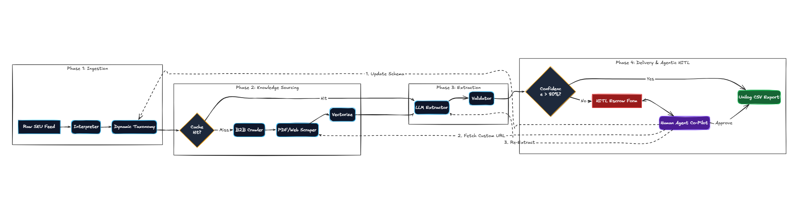
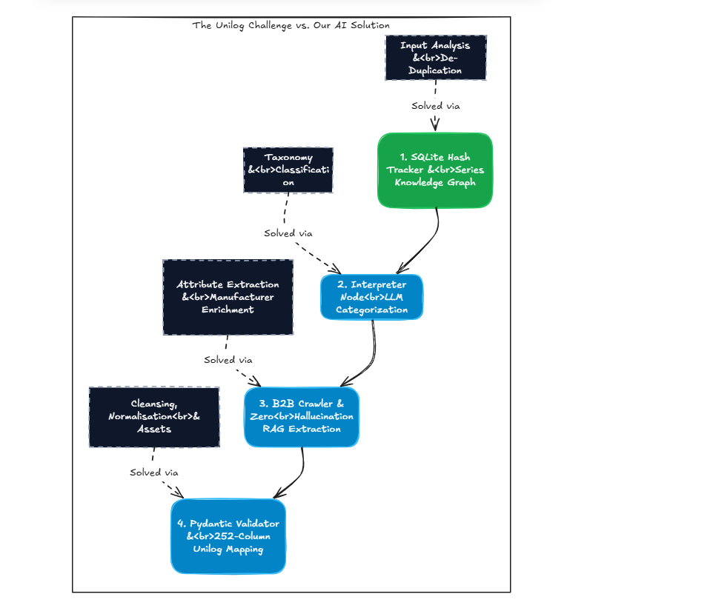

Slide 17
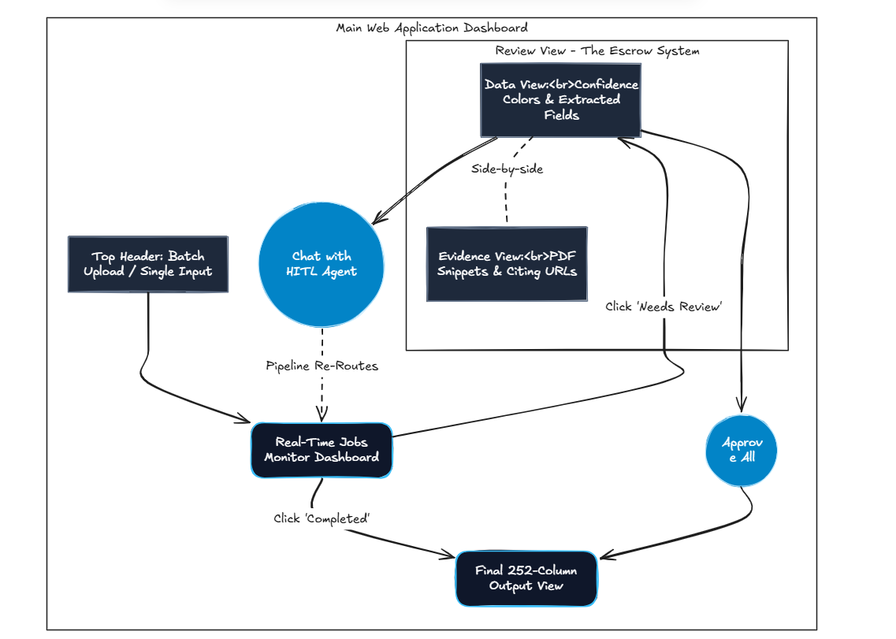

Slide 18
IMPLEMENTATION
Technologies Used & Cost Analysis
Languages & Runtimes
Local Air-Gapped LLM
Cloud Fallback Cascade
Python 3.13, JavaScript (ES6+), HTML5, CSS3
Ollama (qwen2.5:3b) — $0.00 marginal inference cost per SKU
Groq API (llama-3.3-70b-versatile) & Google Gemini 1.5 Pro
AI & Vector Frameworks
Backend Infrastructure
Frontend UI & UX
LangGraph, ChromaDB, Sentence-Transformers, NetworkX
FastAPI, Uvicorn, SQLite 3, PyMuPDF (fitz), Trafilatura, Requests
React 18, Vite, Tailwind CSS, Lucide Icons
COST ANALYSIS & ROI
~$0.001 / SKU
$0.00 / SKU
Primary LLM extraction — runs entirely on air-gapped local Ollama qwen2.5:3b
Search sourcing — Serper API free tier & DuckDuckGo fallback
14 / 15 • Tech Stack & Cost

Slide 19
VALIDATION
Snapshots of the MVP & Project Links
LIVE BENCHMARK TEST CASE — WHIRLPOOL DISHWASHER
PUBLIC PROJECT RESOURCES & CODEBASE LINKS
RAW INPUT TESTED
Brand='APPDE', MPN='WDTS7024RZ', Description='Dishwasher SS'
GitHub Repository
github.com/Charishma1707/product-intelligence
PIPELINE RESOLUTION
Brand corrected to 'Whirlpool Corporation', classified to UNSPSC 83041100 (Built-In Dishwashers).
Interactive Frontend Dashboard
DOCUMENTATION SOURCED
localhost:5173
Official Whirlpool Specification PDF and Owner Manual.
OpenAPI / Swagger Backend Docs
ATTRIBUTES EXTRACTED
localhost:8000/docs
31/31 required Unilog attributes (Voltage: 120V, Current: 15A, Noise: 47 dBA, Tub Material: Stainless Steel).
COMMERCIAL OUTPUT (INVOICE COPY, ≤40 CHARS)
DISHWASHER SS 120V 15A 50-1/4IN
Built for UniHack — Product Intelligence & Automated Catalog Enrichment
15 / 15 • MVP Snapshots & Links

Slide 20
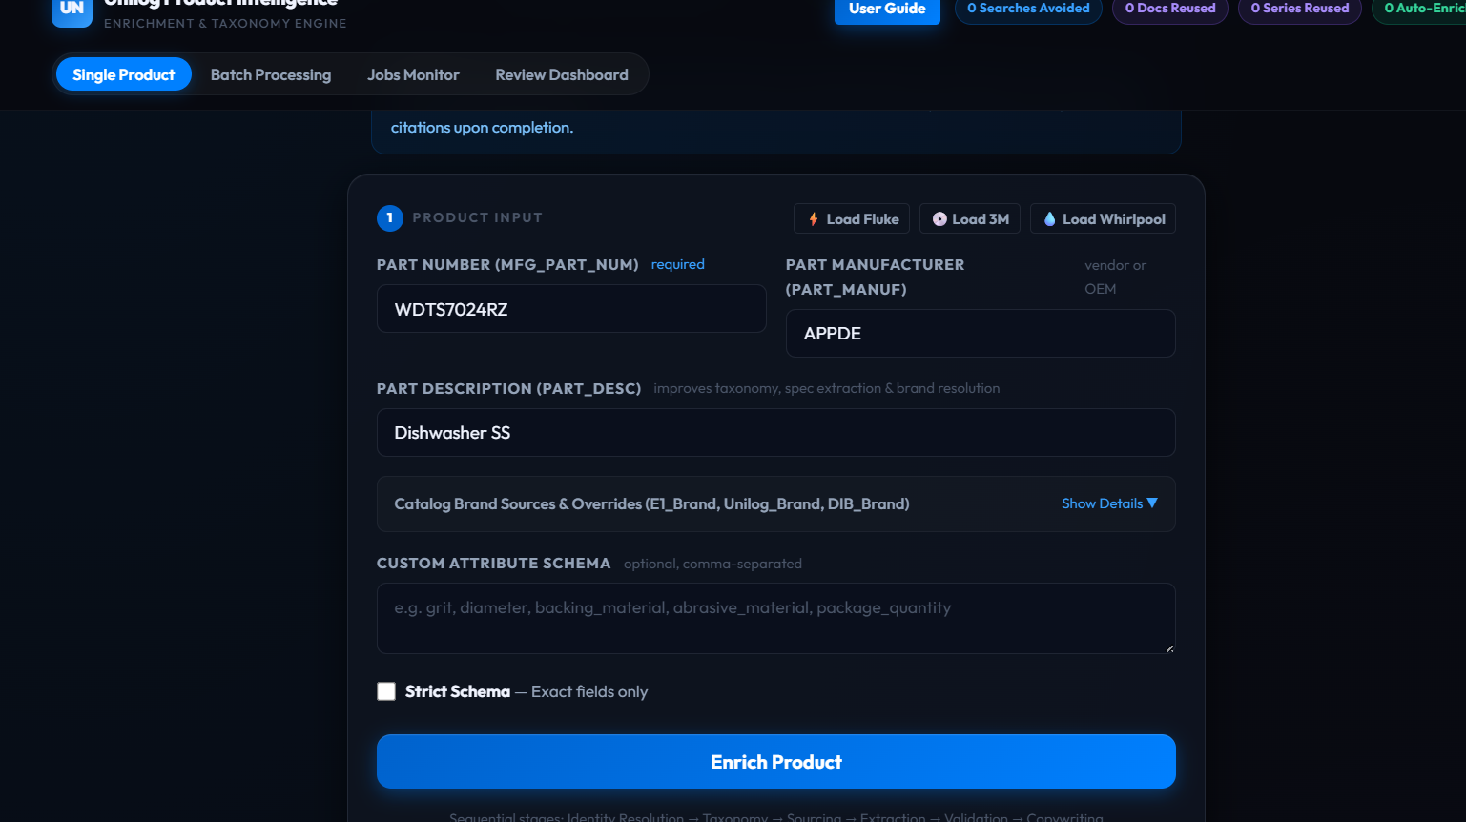

Slide 21
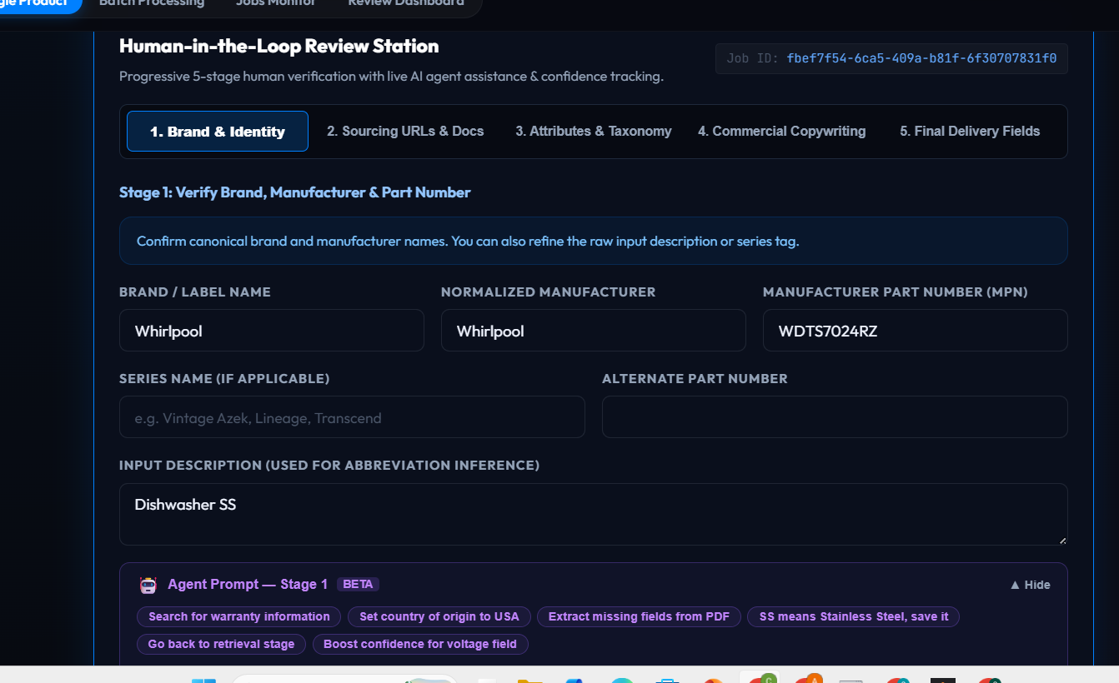

Slide 22
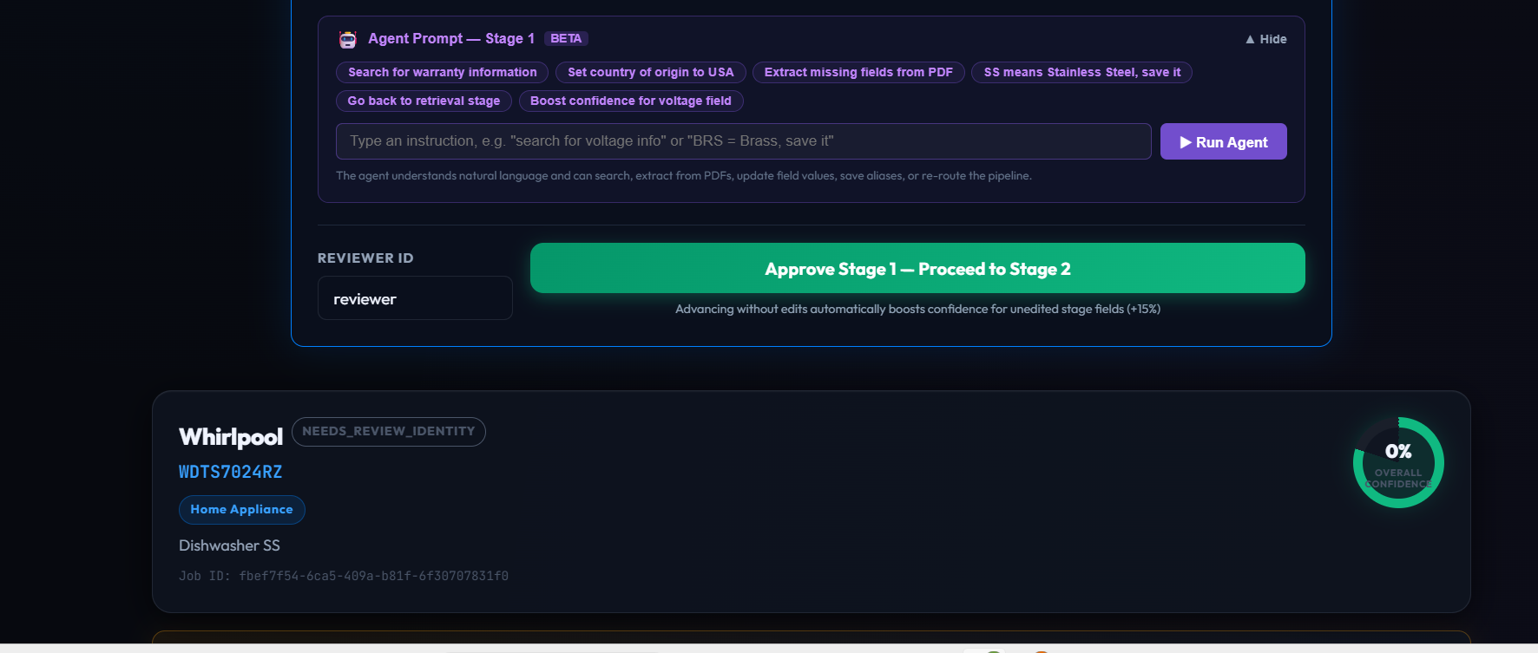

Slide 23
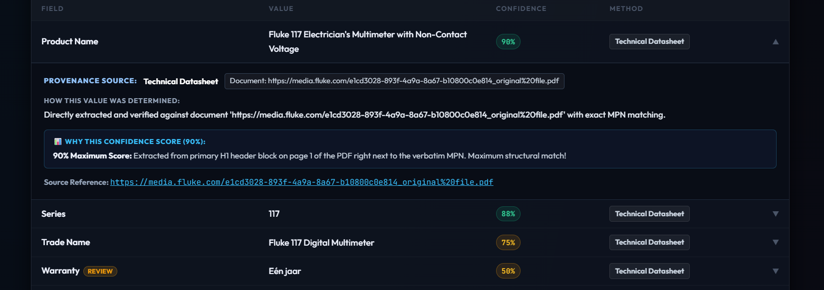

Slide 24
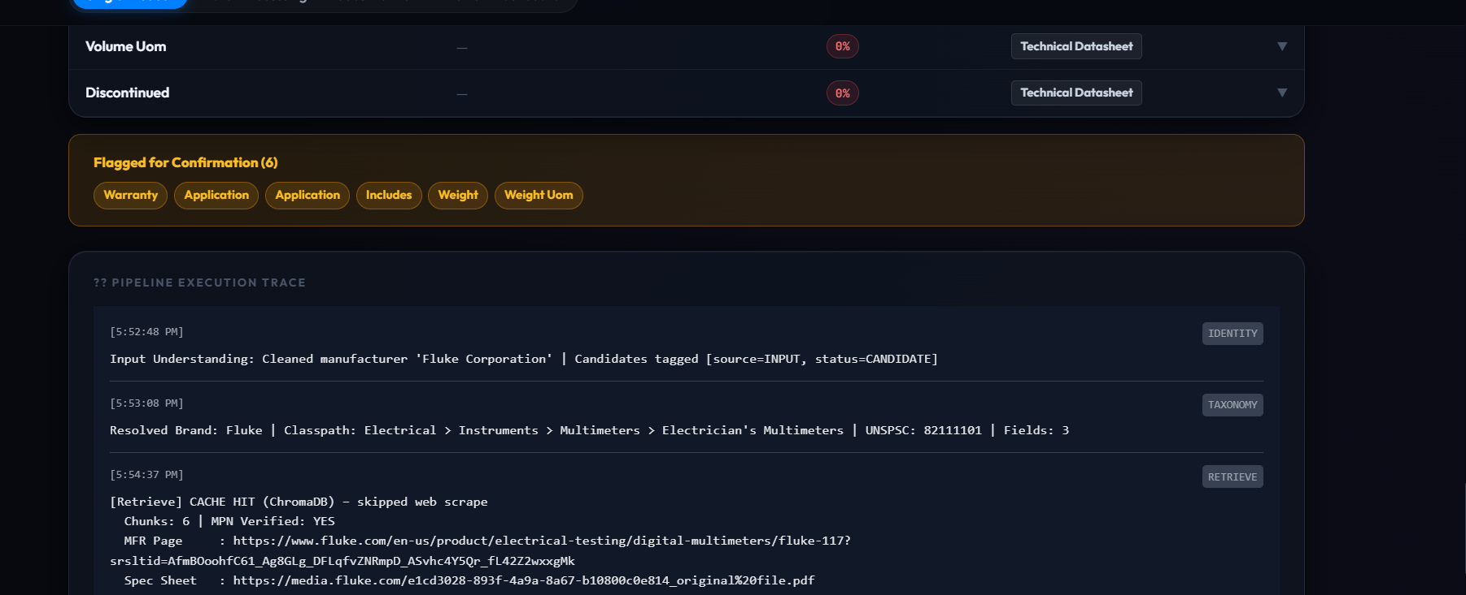

Slide 25
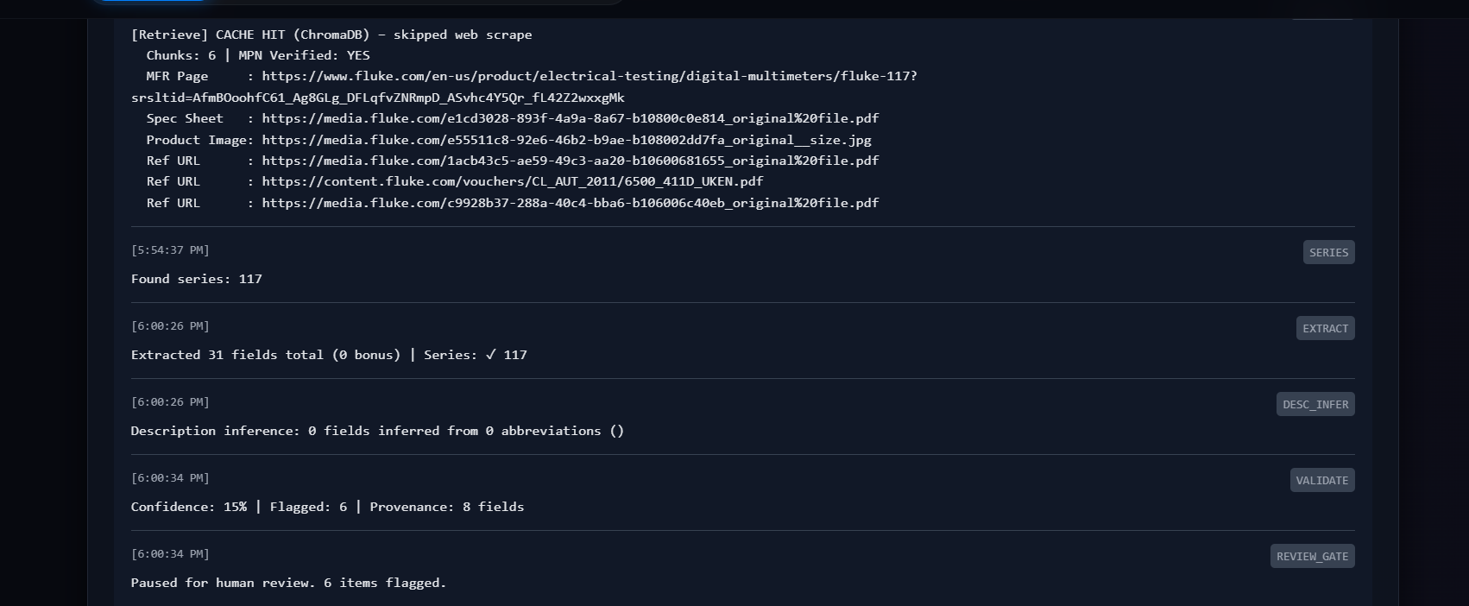

Slide 26
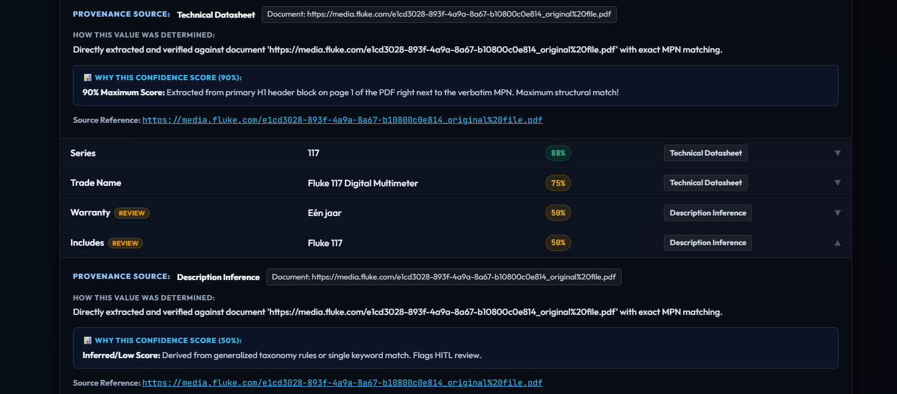

Slide 27
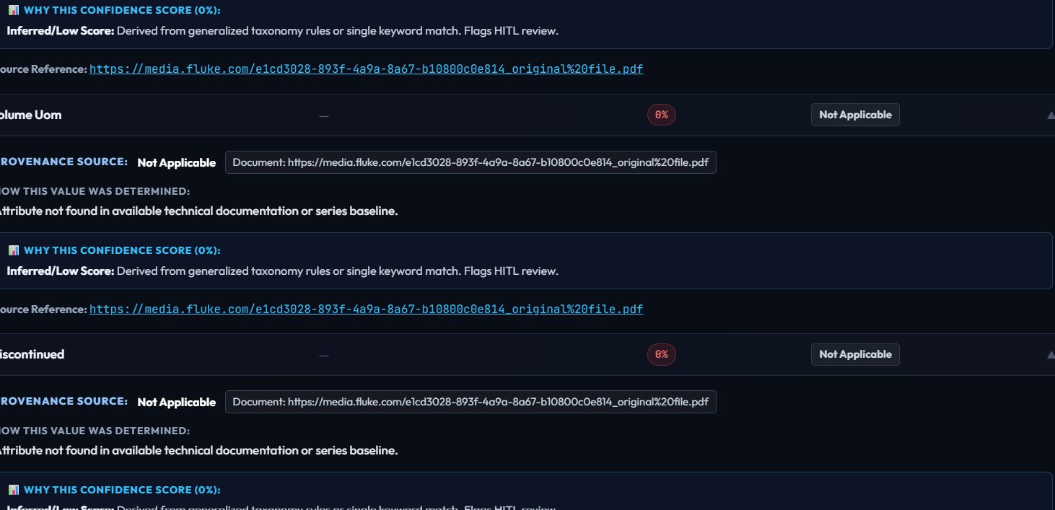

Slide 28
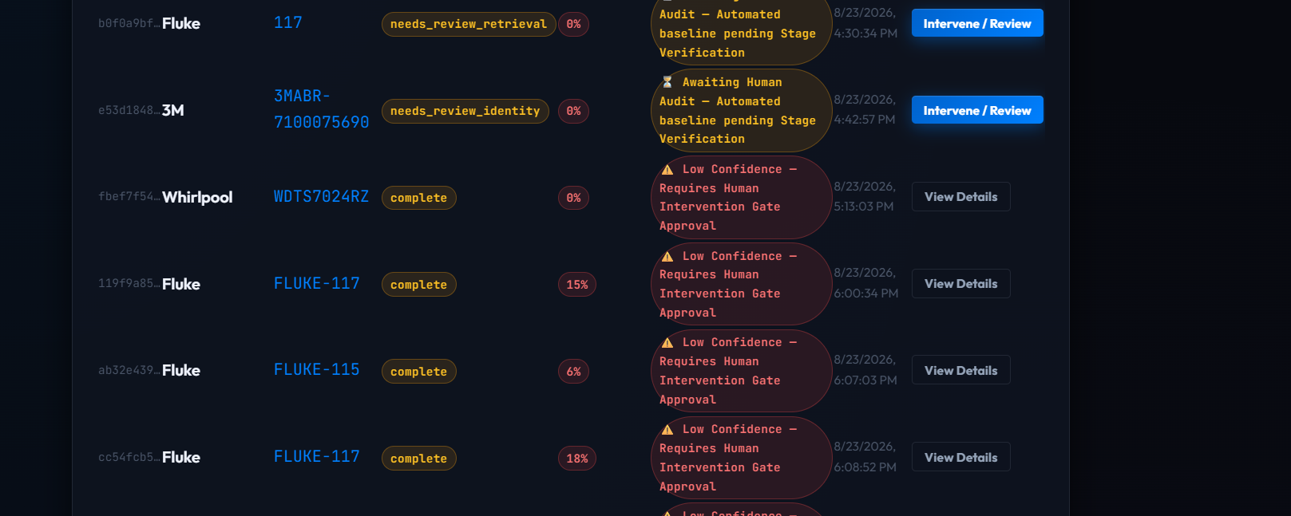

Slide 29
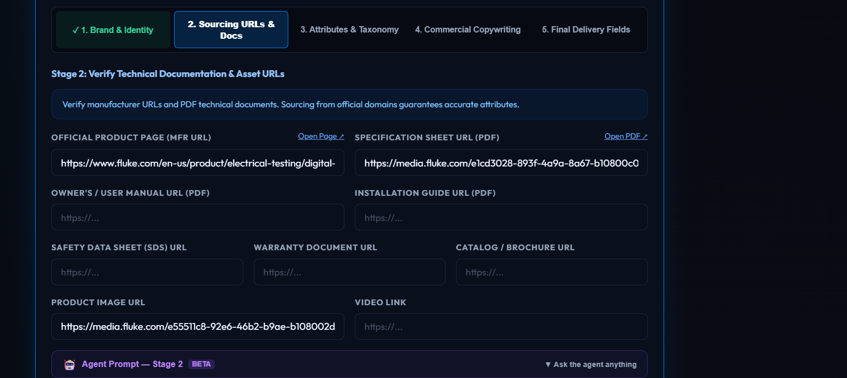

Slide 30
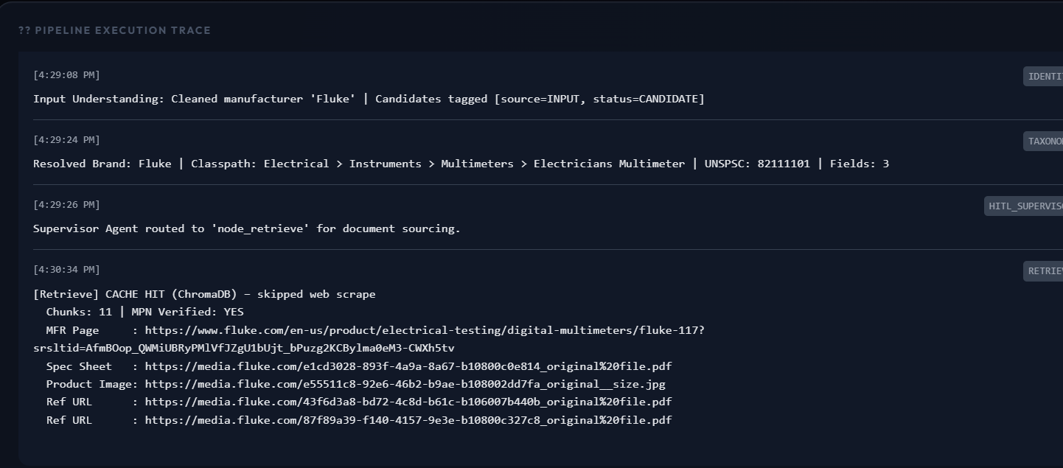
i tested with similar series products ,to knwo is the pipeline using cache ,knowledge graphs (known already)
cache hit for documents,supervisor agent is the agent which decides what to do after admin prompt

